Slide 1
Employee Management System
Shruti Anandas
Employee ID: 207015
shruti.anandas@amdocs.com

Slide 2
Agenda
Introduction
Project Structure & Workflow
CRUD Operations
Technologies
Conclusion

Slide 3
Introduction
Objective
Manage Employee Data: Add, View, Update, Delete
User Authentication with Registration & Login
Technologies
Python
MySQL Workbench
SHA-256 for password hashing

Slide 4
Project Structure & Workflow
User authentication: Register > Login
Employee Operations (CRUD): Create, Read, Update, Delete
Database Tables:
users – Stores username, password & email
employees – Stores employee details

Slide 5
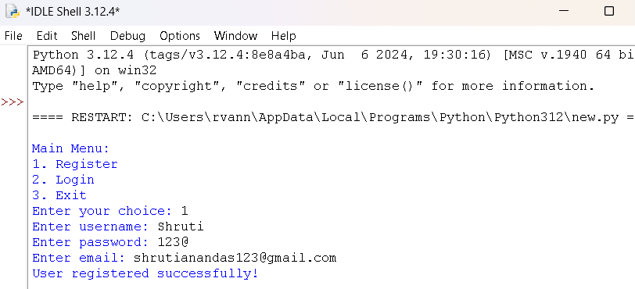
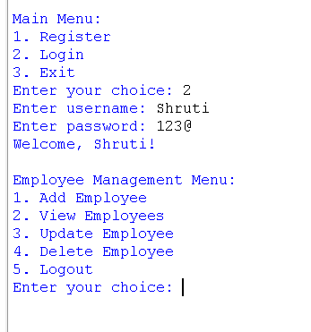
Registration & Login Flow

Slide 6
Employee Operations
CRUD Operations

Slide 7
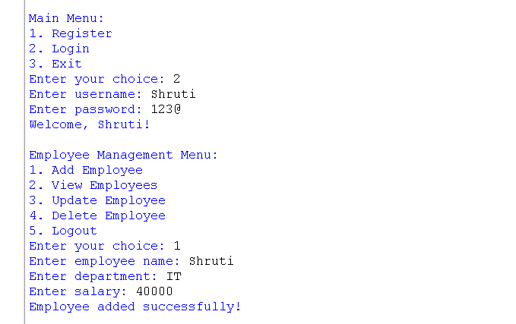
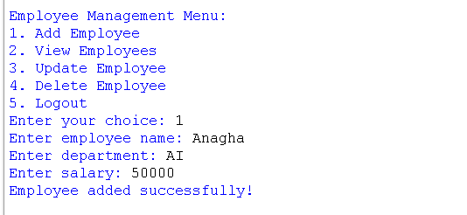
Add Employee
Similarly add all 5 employees

Slide 8
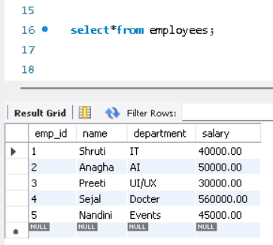
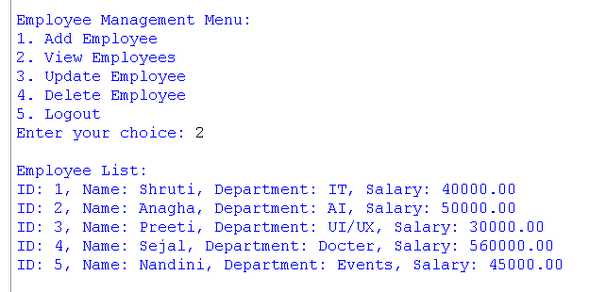
Read Operation
Workbench

Slide 9
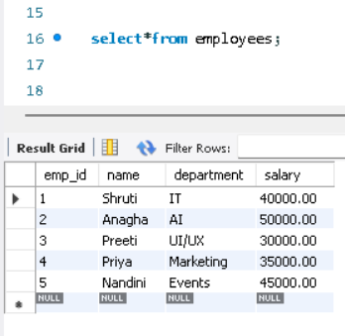
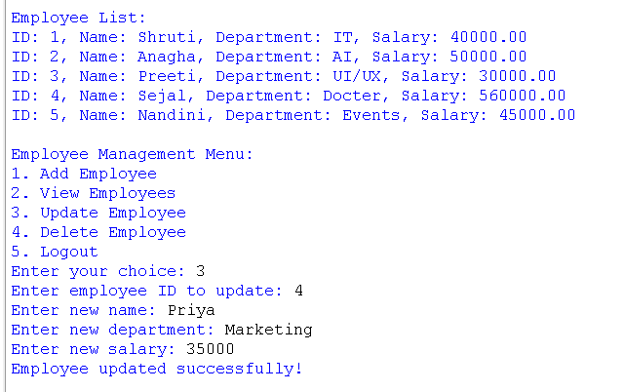
Update Operation
Update Employee No. 4
Workbench

Slide 10
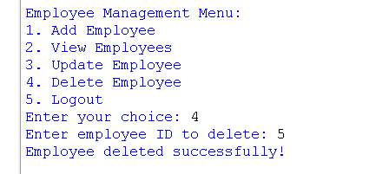
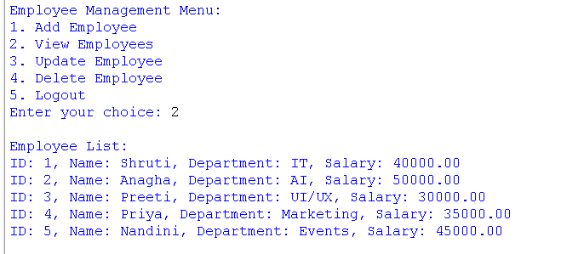
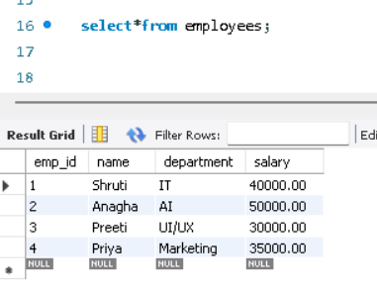
Delete Operation
Delete Employee No. 5
Workbench

Slide 11
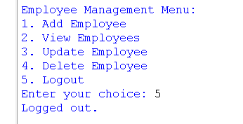
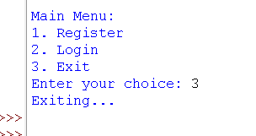
Logout Exist
Logging out & Existing the system

Slide 12
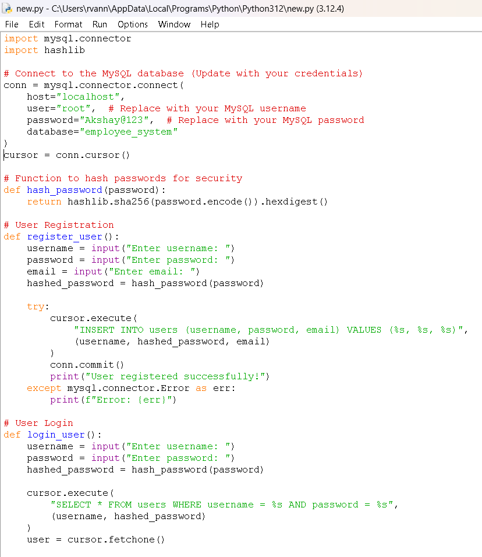
Code Walkthrough - Modules
Importing Required Modules
mysql.connector connect Python to a MySQL DB
hashlib to store user passwords securely
- SHA-256 hash
Database Connection Setup
mysql.connector.connect()
cursor = conn.cursor() to execute SQL queries

Slide 13
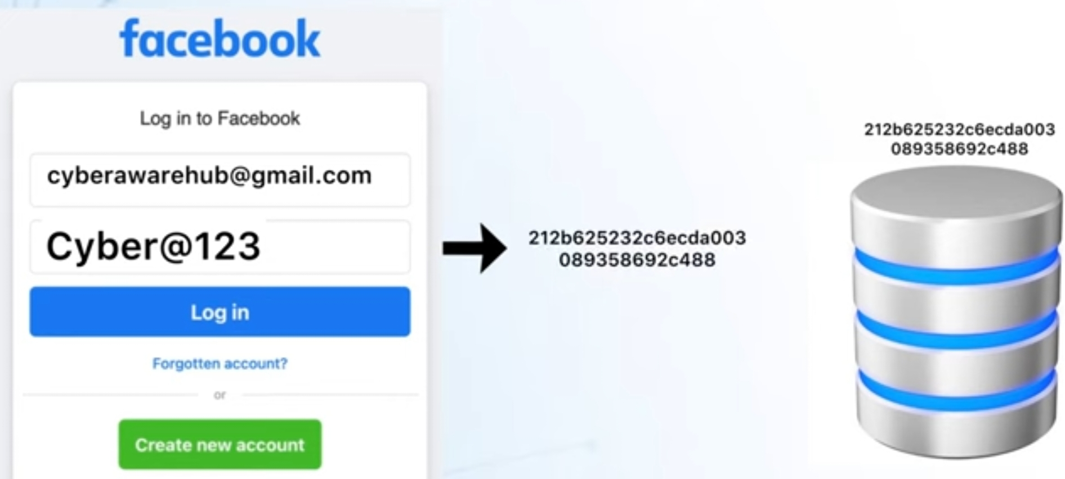
Hashing Function
Fixed size hash value
Output is Unique for every input
Protects against database leaks
Irreversible hash ensures security

Slide 14
Code Walkthrough – User Registration
User Registration Function
User Login Function
Add Employee Function
View Employees Function
Update Employee Function
Delete Employee Function

Slide 15
Error Handling
Error Handling Example:
try:
cursor.execute(‘…’)
except mysql.connector.Error as err:
print(f’Error:{err}’)
Prevent Program Crashes
Execute Alternative Code
Improves user experience by showing meaningful error messages.

Slide 16
Conclusion
The project provides a solution for employee management with secure user authentication.
Secure: Implements hashing to protect sensitive employee information.
Efficient Data Management: Supports seamless CRUD operations for employee records.
User-Friendly: Combines Python’s simplicity with SQL for fast, easy data handling.

Slide 17
Thank you
Shruti Anandas
Employee ID: 207015
shruti.anandas@amdocs.com

